Slide 1
Fairness Consideration in Digital Twin
Digital twin of Bologna Socio-Economic Landscape
Francesco Cavaleri, francesco.cavaleri2@studio.unibo.it
Giacomo Piergentili, giacomo.piergentili2@studio.unibo.it

Slide 2
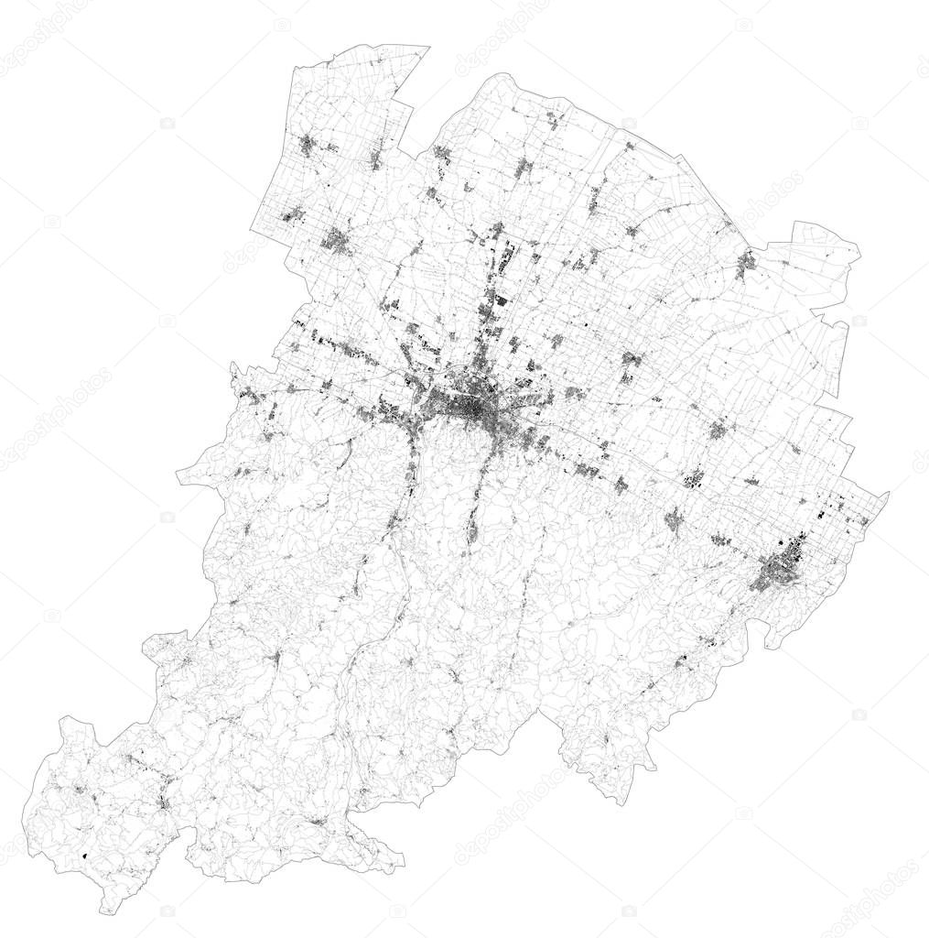
Goal of the project
Develop a digital twin to understand how different socio-economic groups interact with Bologna's urban infrastructure and evaluate the fairness of mobility policies.

Slide 3
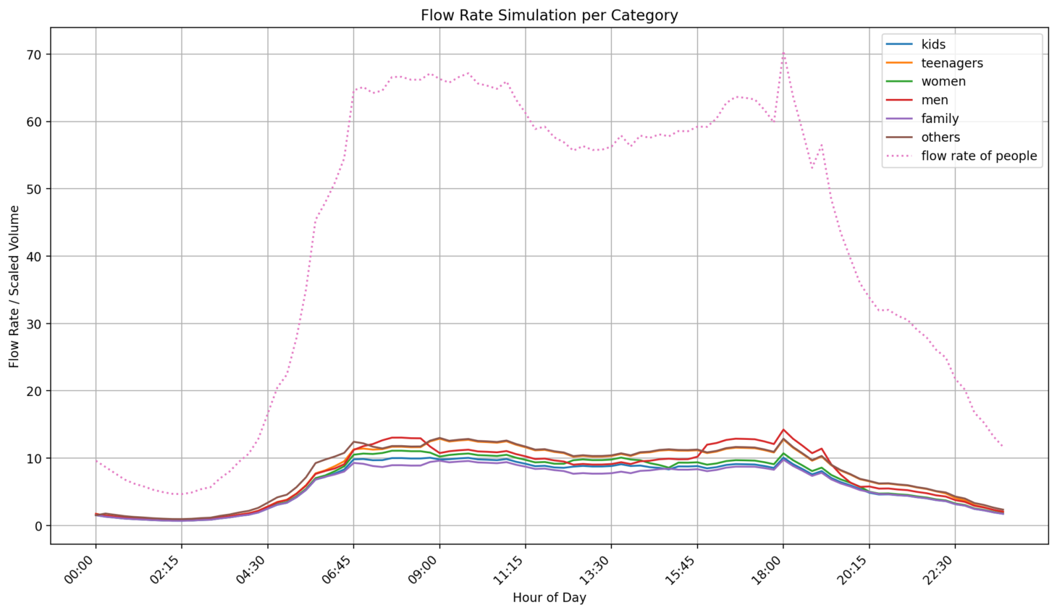
Part of "Digital Twin for Fairness in Bologna" Initiative
Focus: Simulate and analyze socio-economic groups' interaction with city infrastructure
Purpose: Help policymakers evaluate social and economic impact of urban planning decisions
Fairness: Explicit focus on fairness evaluation, not just efficiency

Slide 4
Data Integration
Key Data Sources
City gates (Porte) locations and traffic flow
58 educational institutions (public/private)
Green areas and public spaces
Traffic flow rates at city gates
System capabilities
Identify mobility patterns at key city gates
Simulate policy impacts on different groups
Support evidence-based decision making

Slide 5
Bologna’s Urban Challenge
Mobility policies impact:
Families with children: Need flexible transportation for school commutes and activities
Lower-income residents: Face barriers accessing central city services from peripheral areas
Key Challenge: City gates serve as critical control points for traffic management and potential points of inequity if not managed with fairness considerations

Slide 6
Demographic Categories & Mobility Patterns
Target groups
Families with children: Complex mobility patterns, multiple stops
Children: Depend on safe pedestrian access to schools
Teenagers: Price-sensitive, rely on public transportation
Adult men/women: Different mobility patterns, both having children
Others: category for all missed people, enabling comprehensive coverage
Multi-modal Weighting System
Captures how urban attributes affect each demographic group differently
Example: Proximity to public schools has high weight for children and families, minimal importance for young adults without children

Slide 7
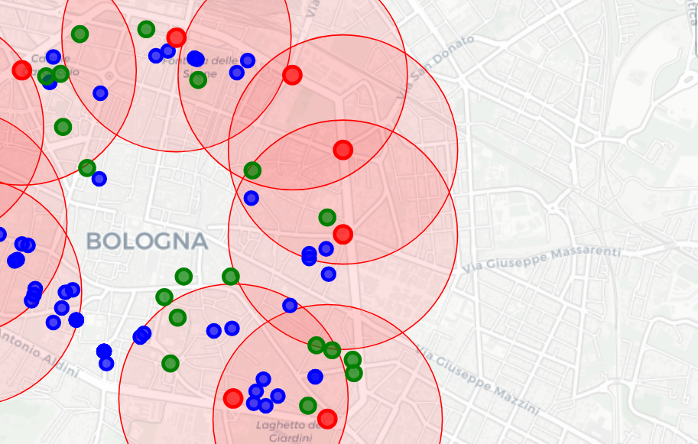
Urban mobility is inherently tied to fairness and equity
Some features of our simulator:
Accessibility Analysis: Range-based framework (650-750m radius ≈ 10-minute walk)
Spatial Representation: Integration of gates, schools, and green spaces
Temporal Dimension: Probabilistic models for different time periods
Fairness Evaluation: Effort-based cost function for each demographic

Slide 8
Fairness Evaluation Framework
Central Concept: "Effort" as Cost Function
Quantifies accessibility burden experienced by each demographic category
Evaluation Process:
Baseline Effort Scores: Establish reference points for current accessibility
Policy Impact Simulation: Recalculate scores based on modified attributes
Fairness Assessment: Compare relative burden changes across groups
Evidence-based Decisions: Identify and mitigate unfair burdens on specific segments
Innovation: Optimize for equity alongside traditional efficiency metrics (traffic flow, revenue)

Slide 9
Effort cost function
The evaluation begin with evaluation of the Effort score by each demographic category.
When the program starts effort scores integrates spatial attributes of the city gate. In that way the initialization takes into account the exact features of that location, creating a more reliable simulation.
CATEGORY | KIDS | TEENS | WOMEN | MEN | FAMILY
EFFORT | 3,98 | 2,87 | 3,46 | 2,09 | 4,78

Slide 10
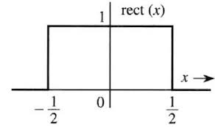

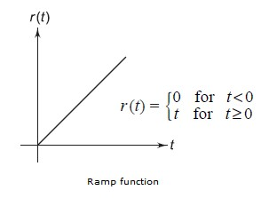

Temporal Dimension - Mathematics under it
Equation Building Blocks

Slide 11
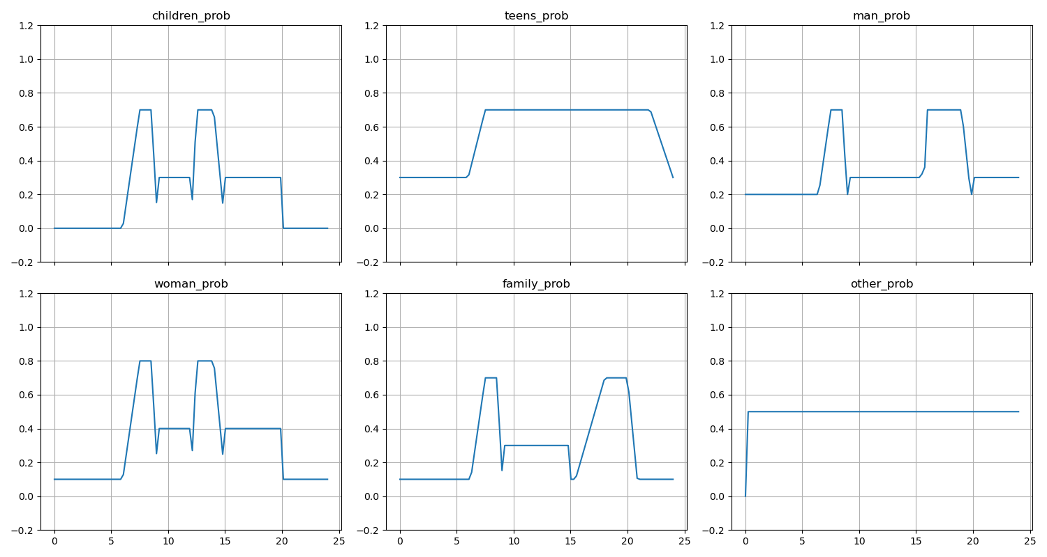
Temporal Dimension
Time-based Probability Functions
Different demographic groups show distinct temporal patterns throughout the day
Families: "Double peak" pattern tied to school schedules (morning drop-off, evening pickup)
Children: Mobility concentrated during school transport hours
Adults: More distributed patterns across workday hours

Slide 12




Evaluate Demographic Distributions
Steps:
Effort-to-probability conversion
Time-dependent scaling
Softmax
Demographic count estimation

Slide 13
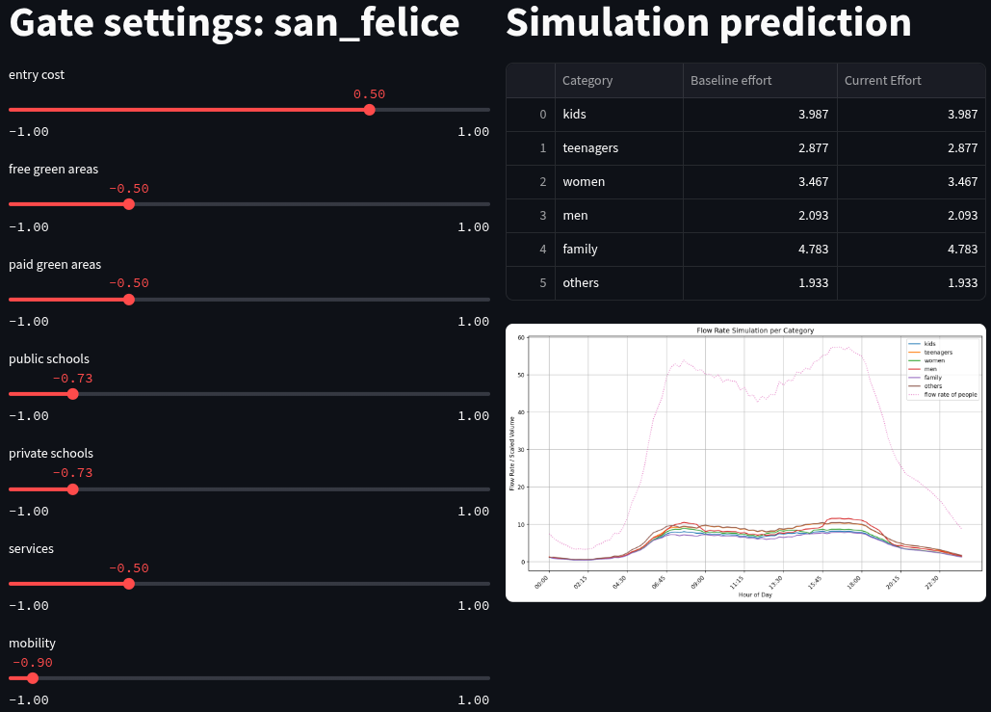
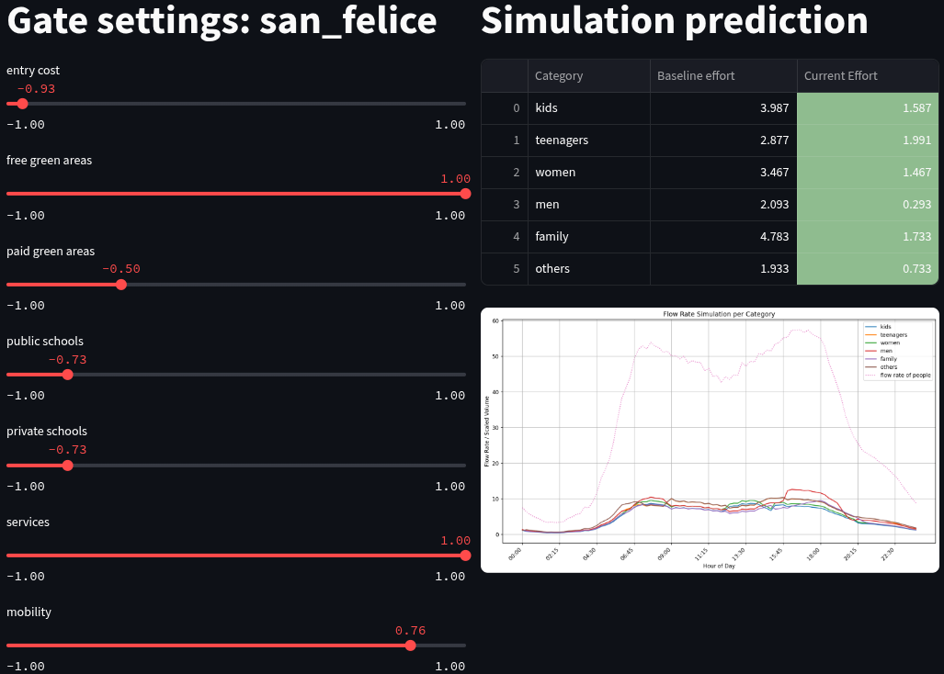
Preliminary Results

Slide 14
Multi-model and Key findings
Learning from Real Datasets
Exploiting real dataset allows us to learn, starting from actual urban data, demographic weights and temporal patterns
Key Results:
Green Spaces: Analysis of park visitation data can reveal actual preferences across age groups and family types
School Proximity Patterns: simulation can quantify how proximity to schools affects different demographics
Economic Sensitivity: Transportation card usage and parking data can show price responsiveness
Multi-model Applications:
Gaussian Mixture Models: Can learn temporal patterns from traffic sensor data
Neural Networks: Can predict demographic features based on the time of the year
Clustering Analysis: Can identify natural demographic groupings from mobility data

Slide 15
Visualization & Analytical Approach
Interactive Visualization System
Technical Features:
Multi-layered map visualization
Dynamic demographic impact charts
Real-time parameter adjustment
Spatial relationship exploration
Stakeholder Benefits:
Makes complex spatial relationships accessible
Supports non-technical stakeholder communication
Makes fairness considerations visually apparent
Dual Purpose: Serves both analytical exploration and stakeholder communication for inclusive urban planning discussions

Slide 16
Implications for Urban Policy
Key Policy Considerations:
Equity in Access: Spatial distribution reveals potential disparities in educational facility access
Traffic Management: Flow rate of people indicate opportunities for targeted peak hour management
Green Space Accessibility: Identifies areas for improvement, especially near schools
Fairness-Centered Planning:
Enable rejection of policies that create unfair burdens on specific population segments
Simulate before implementation
Consider demographic impacts
Balance efficiency with equity

Slide 17
Limitations & Future Work
Current Limitations:
Demographic weights based on assumptions, not Bologna-specific research
Straight-line distance calculations vs. actual street routes
Simplified demographic categories
Mathematical probability functions vs. real traffic data
Future Enhancements:
Machine learning for parameter estimation
Gaussian Mixture Models for temporal patterns
Statistical areas instead of gates
Transportation network integration
Sociological validation through surveys
Complex multi-model simulation

Slide 18
Conclusion
First Digital Twin Framework for Bologna
This represents the first iteration of a digital twin system specifically designed for the city of Bologna, focusing on fairness in urban planning
Key Achievements:
Pioneer Implementation: No comprehensive digital twin existed for Bologna before this project
Fairness Focus: First framework explicitly designed to evaluate equitable impact of urban planning decisions
Methodological Foundation: Establishes baseline methodology for fairness-aware urban simulation
Extensible Framework: Modular design allows for future enhancements and integration with additional data sources
Future Impact: This first iteration establishes the groundwork for more sophisticated fairness-aware digital twins, enabling policymakers to create more equitable and data-informed approaches to mobility management and social policies implementation in Bologna and potentially other cities.

Slide 19
THANK YOU FOR YOUR ATTENTION
Do you have any question?

